Slide 1
MUTUAL LEARNING EXERCISE ON R&I STRATEGIES AND POLICIES
Session 6: Policy Monitoring & Evaluation
Challenges for STI Policy Evaluation
Dimo CALOVSKI (Mr.)
Science, Technology and Innovation Policy Section
UNCTAD Division on Technology and Logistics
dimo.calovski@un.org
Addis Ababa, Ethiopia
14-17 February 2023

Slide 2
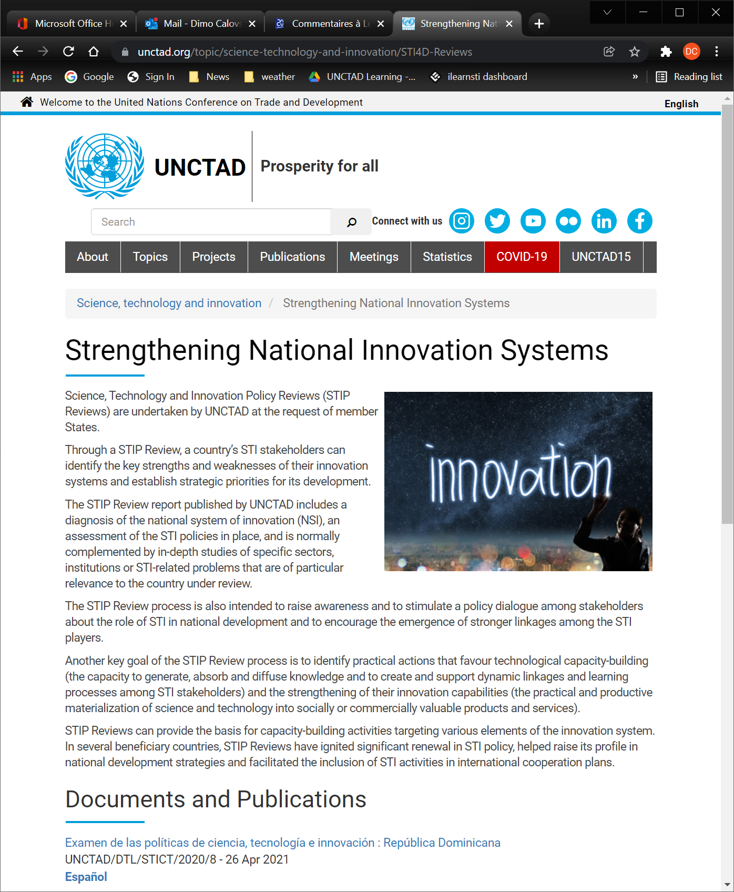
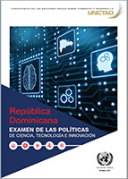
UNCTAD STI Policy Reviews
Botswana
Zambia*
Dominican Republic
Uganda*
Ethiopia
Panama
Rwanda*
Iran
Thailand
Oman*
El Salvador
Ghana
Peru
Lesotho
Mauritania
Angola
https://unctad.org/publications-search?f[0]=product%3A635

Slide 3
UNCTAD STI Policy Reviews
Botswana
Zambia*
Dominican Republic
Uganda*
Ethiopia
Panama
Rwanda*
Iran
Thailand
Oman*
El Salvador
Ghana
Peru
Lesotho
Mauritania
Angola
OBJECTIVE:
https://unctad.org/publications-search?f[0]=product%3A635

Slide 4
Focus: Assisting policy making in STI
Situation: modest Monitoring & Evaluation process, … but new policy being prepared or revised
Policy evaluation, assessment of NSI
Assessment of innovation performance
Goals and outcomes
How to move forward?

Slide 5
Focus: Assisting policy making
Situation: modest Monitoring & Evaluation process, … but new policy being prepared or revised
Policy evaluation, NSI assessment
Assessment of innovation performance
Goals and outcomes
How to move forward?

Slide 6
1. Policy evaluation, NSI assessment
STI policy under review
Coherence with national development strategy, SDGs?
Development strategy recognises STI?
Outreach to other policies?
All other policies
Acknowledgement of S,T and Innovation?
Are policies inter-related?
Implementation matrix (who does what?)
Collaboration, joint activities?
Notes:
STI policy under review
Coherence with national development strategy, SDGs?
Does development strategy recognise STI?
Outreach to other policies and policy domains?
All other policies
Implicit or explicit acknowledgement of S,T and Innovation?
Are policies inter-related?
Inspect implementation matrix (who does what?)
History of collaboration, joint activities?

Slide 7
National System of Innovation (Innovation Ecosystem)
Framework for policy design?
Mapping of NSI?
Information gatekeepers?
Reporting directions and information flows
Within the STI policy?
Among STI stakeholders? (horizontal flows)
Development of a consensus narrative – what works, what doesn’t
Cannot replace data, but may provide insight
Data does not provide the narrative
Discussions with a many diverse stakeholders
Notes:
Reporting directions and information flows
Within the STI policy? (funds/agencies > ministries > cabinet, top-down, bottom-up)
Among other STI stakeholders? (horizontal information flows)
National System of Innovation (Innovation Ecosystem)
Is it used as framework for policy design? (… implicit or explicit?)
Mapping of system and sub-systems – exercise for STI agency and stakeholders?
How strong are information gatekeepers?
Development of a consensus narrative – what works, what doesn’t
Cannot replace data, but may uncover truths, provide insight
Data does not provide the narrative – just the dots, not the connections
Requires discussions with a large number of diverse stakeholders

Slide 8
STI policy under review, does it …
Coherence with national development strategy, SDGs?
Blueprint for a better and more sustainable future for all?
Provide for directionality?
Key challenges are interconnected!

Slide 9
Objective: Profound transformation driven by fast-evolving and converging technologies
No definitive list of technologies
Some common features of SDG technologies
Fast change, short adaptation cycles
Soft technology, mind frame change
Lower costs, more choices
Open science, technology and innovation
New forms of work and inclusiveness
Innovation addressing change, disruptive innovation, creative destruction

Slide 10
Current STI developments and SDGs
Precision agriculture: SDGs 1, 2, 9, 12, 15
Water management, wastewater treatment and nutrient recovery: SDGs 6, 9, 11, 15
Circular economy: SDGs 6, 7, 13, 14, 15 > residual, waste = resource for products, energy
Transformative technologies: SDGs 3, 4, 8, 9, 10 > exponential growth, impact, strong links with ICTs (e.g.: AI, IoT, robotics, autonomous V, blockchain, 3D printing-additive mfg.)

Slide 11
4. How to move forward?
Many UN and other International Organizations do policy reviews
International consultancy firms, local research institutions
Decisions are needed – good will is not enough:
Address an underlying policy process
Define objectives, goals – what is to be achieved?
Establish who are the STI stakeholders, map the NSI (names of specific organizations, firms and industries)
Develop commitment: timeline, funding and human resources
Importance of external evaluation with no vested interests in the outcome
Any/all IATT WS6 agencies can guide and help

Slide 12
THANK YOU!

