Slide 1
MUTUAL LEARNING EXERCISE ON R&I STRATEGIES AND POLICIES
Jessica D’Unienville
Principal Research Officer
Division of Science Technology and Innovation
Ministry of Investment, Entrepreneurship and Industry
Seychelles
Addis Ababa, Ethiopia
14-17 February 2023

Slide 2
INNOVATION IN SEYCHELLES
Launching of STI Policy and Strategy 2016-2025
Restructuring of NISTI to become DSTI
NISTI was created
Cabinet approval for the setting NRF and BTI
2015
2016
2017
2018
2019
2020
2021
Initiating discussion of digitalizing the STI indicator Survey on the African Continent
Carry out of the 1st Innovation Indicator survey
Launching of the Innovation booklet

Slide 3
National Development Priorities
Transformative Economy
Modern Public Service
Modern and more efficient health system
Modern education system
Promotion of law and order
Environmental sustainability and climate change resilience

Slide 4
Relevant STI Policies
Science, Technology and Innovation Policy
Industrial Policy
Entrepreneurship Policy
Research Policy
Transformative Innovation Policy
Digital Entrepreneurship Policy
A new policy is being developed
Due for a review
Being developed
Planned for development 2023/2024
Planned for development 2023
Planned for 2024

Slide 5
Policy Landscape
National custodian of Science, Technology and Innovation Policy and Strategy:
Division of Science, Technology and Innovation (DSTI) under the Ministry of Investment, Entrepreneurship and Industry (MIEI)
Mission
Embed science, technology, research and innovation into the socio-economic transformation of Seychelles to spur knowledge-driven and value-added sustainable growth for improving the quality life of its people

Slide 6
Objectives
Strengthen Research Potential and Research Capacity
Finance STI (GERD & Institutional Arrangements)
Promote Innovation and Entrepreneurship
Create a Knowledge Society
Manage National Research Data
Improve the well being of the people

Slide 7
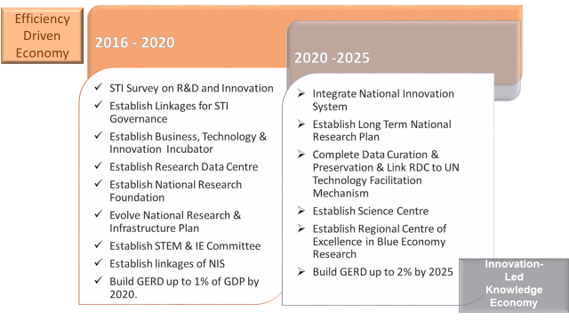
STRATEGIC IMPLEMENTATION TIMELINES
PRIORITY
NEAR COMPLETION

Slide 8
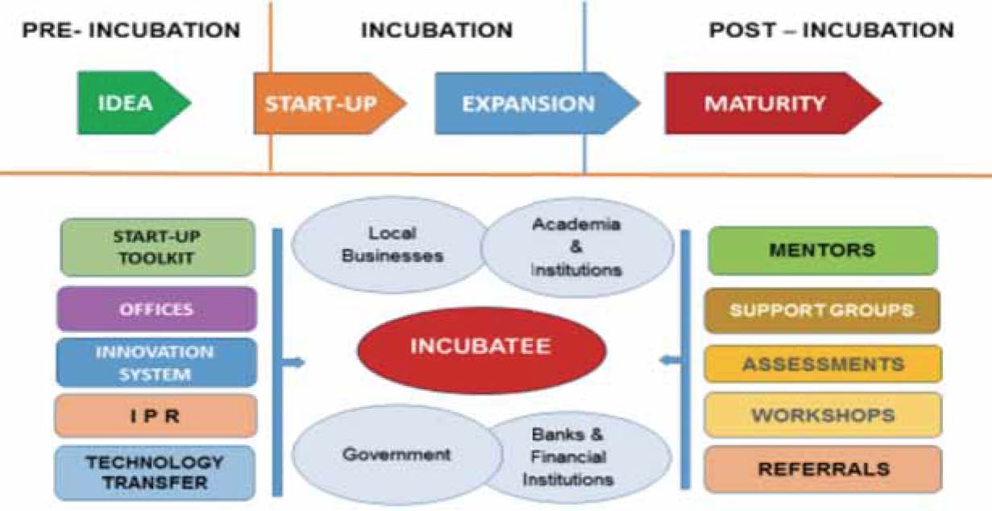
Seychelles Business Technology Innovation (BTI) Incubator Eco-System
The BTI Incubator will be established under the aegis of the Ministry of Investment Entrepreneurship and Industry as per the outline structure depicted below:

Slide 9
STI Landscape…
# of Research Institutions:
1 Public University
10 technical vocational education and training (TVET)
Non-Governmental Organization (NGOs)
Key National Research Organisations:
SAA: Seychelles Agricultural Agency (SAA)
SFA: Seychelles Fishing Authority
PHA: Public Health Authority
NGOs: A number of NGOs conducting research in environment

Slide 10
STI Funding Landscape…
Key Research Funding Sources:
Government Departmental Budget
International Philanthropic
International and Regional Organization eg: EU, WHO
Research Fund (Government Funding): This is still in the process of being set up. Vision: To encourage private funders contribution to the fund in the future.
Key Innovation Funding Sources:
SEED Capital: For Micro, Small to Medium Enterprises

Slide 11
SWOT Analysis
STRENGTHS | OPPORTUNITIES
Availability of supporting physical infrastructure; Good Science Technology and Innovation policy and strategy framework; Good ICT infrastructure (hardware); Clear legal mandates, roles and functions; Competent and professional available workforce; Good working relationship and teamwork; Well-establish local, regional and international networks and collaboration; and Leadership driven by passion and commitment. | Weak National Innovation System; Low access to credible and public information; Absence of open data access system at national level; Absence of Tech transfer system and a national system to coordinate tech transfer Inadequate IP framework to support technology and innovation No Research & Development coordinating framework; Ratified SADC STI Protocol; Absence of baseline data to determine GERD as % of GDP; Overall system poorly support the ease of doing business; Presence of some emerging indigenous technologies; Absence of knowledge transfer between industries and universities; and Physical location in the most affluent region of the country.

Slide 12
WEAKNESSES | THREATS
Short of human resources to implement strategies and objectives and deliver quality services; Reluctance to make use of social media due to a culture of keeping to oneself; Insufficient implementation of administrative structure in planning and organization; Insufficient integration of technology and innovation in day-to-day working of organization; Unreliable Wi-Fi Internet connectivity; High-skilled labor force not available locally; Turnover of the staff in the R&D section; Absence of own scheme of service to attract cadres; Lack of formal health and safety regulations and procedures in workplace; Insufficient transportation facility for staff movement; Poor Research & Development capabilities; and No formal funding for Research & Development and Innovation. | Inconsistency and focus of government to the advancement of the organization; Keeping NISTI at arm-length attitude of key stakeholders; Insufficient budgetary support; and Low level of appreciation of STI across all spectrum of society.

Slide 13
Success…..
Achieved most of the objectives of the policy: Currently policy is under review by UNCTAD
Establishing a conducive STI environment: resources, policies, clear management support, good governance,
Developing a culture of innovation: publish or perish paradigm - need to incentivize/reward innovation activities
Setting up of BTI: Incubator for start ups and entrepreneurs
Establishing a good STEM environment: Successful extra-curricular activities in school
Technology Assessment : Currently the project is going on

Slide 14
Challenges
Establishing a culture of research and development: To encourage research in the industry and the MSMEs space
Ability to carry out the survey: Human capacities
Appropriately skilled human resources: to effectively support STI development
Financing : critical for knowledge generation and dissemination
Developing of the National System of innovation: To develop a collaborative relationship between the Industry and the University and the government, to ensure more R&D
Lack of funding: To set up and manage to office at a national level
Lack of knowledge about RIM: Lack of knowledge and understanding about RIM in the learn society

Slide 15
Conclusions
Conclusions
Despite the numerous setbacks and challenges that have been faced with the implementation of the current STI policy and strategic framework, a number of achievements have been attained, especially in achieving the objectives related to STEM Education.
Experience has proven that it is not solely depends on well-crafted evidence-based policy that leads to a successful implementation of the same. Other factors play key roles such as the right institutional and legal framework, which has been severely disrupted with the restructuring of the former NISTI.

Slide 16
References
Seychelles Science Technology and Innovation Policy 2016-2025
Seychelles Research & Development and Innovation Survey Data
Seychelles National Development Strategy

Slide 17
Thank you Merci Beaucoup Obrigado shukran

