Slide 1
Producing and using science for decision making
Science, Technology and Innovation (STI) Capacity building, Addis Ababa February 2023
Ignacio Sanchez, UNEP
Notes:
Good day and I hope you are all well, thank you for joining for this training session. My name is Ignacio Sanchez and I work for UNEP in the scientific assessments team. I’m here to speak about creating science for decision-making. Thank you to the organizers for hosting this training on this important topic. Most policies require a strong base of evidence, meaning creating science for policymaking is of great importance.
Learning Objective: Goals of the session – creating science for decision-making because policies require evidence to support them
Proposed speaking points
Thank you to the organizers
Speaking about creating science for decision-making and that policies require evidence behind them.

Slide 2
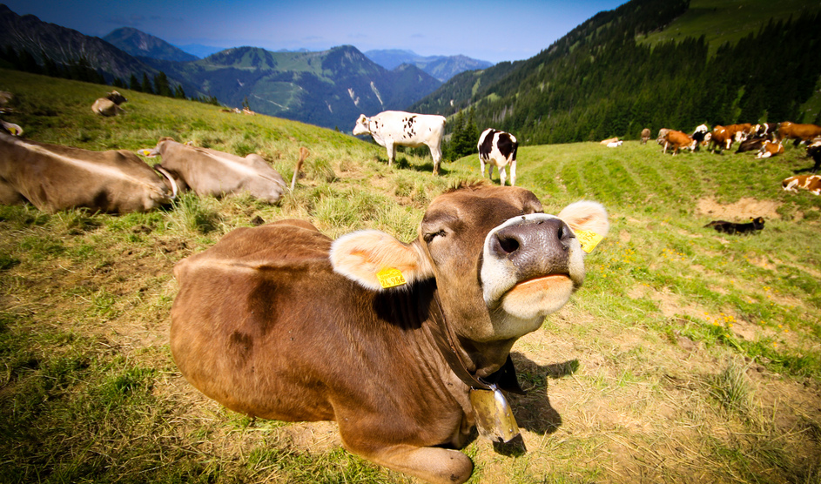
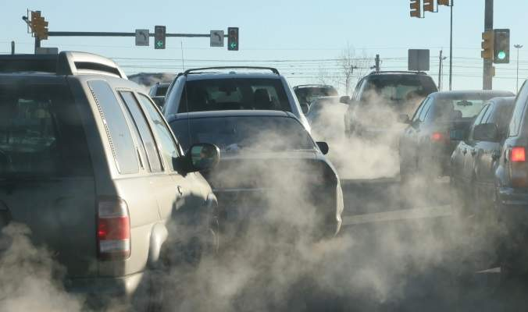
Introduction
¿Who pollutes more?
Notes:
Livestock emissions make up anywhere between 14.5 and 18 percent of total global greenhouse gas emissions. Comparably, the transportation sector is responsible for around 14 percent of emissions. By those numbers alone, our current system of meat production is extremely damaging. Perhaps more looming, however, is that while transportation creates CO2, livestock farming is hugely responsible for producing methane. As you may know, methane is 23 times more potent when it comes to warming the planet.
Segun informe de la FAO: En el decenio de 1990, la superficie forestal mundial se redujo unos 94.000 kilómetros al año, superficie equivalente a la del Portugal. La mayor parte de las tierras desbrozadas y quemadas se destinaron al cultivo y al pastoreo (véase el gráfico 1, p. 2). En América Latina, en particular, casi todas las tierras deforestadas se convirtieron en pastizales para criar ganado en sistemas extensivos de pastoreo. (http://www.fao.org/3/a-a0262s.pdf)
De acuerdo al Ministerio de Medio Ambiente y Recursos Naturales (MARN) en El Salvador existen 80 zonas identificadas como puntos críticos por la deforestación y son puntos claves para proteger los mantos acuíferos y combatir los efectos del cambio climático. Según la la fundación ecológica SALVANATURA, el país tiene un 70% del territorio en graves condiciones de deforestación, índice que ya causa graves consecuencias en los salvadoreños.
Comenzar a relacionar con el pensamiento de ciclo de vida y la importancia de mirar todas las etapas y los impactos que se generan en cada una de ellas.

Slide 3
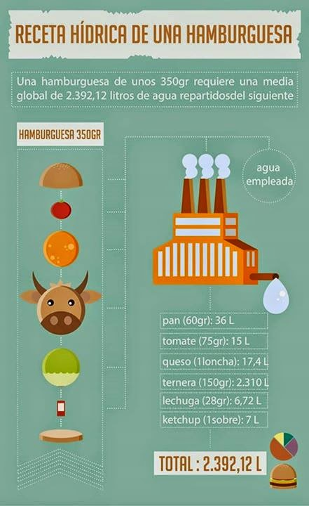
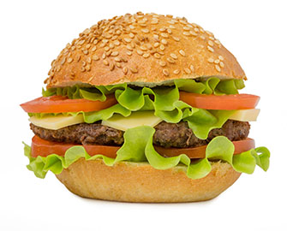
Introduction
¿Who has a bigger water footprint?
Notes:
Una ducha de 10 minutos consume 200 litros de agua, según datos de la OMS
La media de consumo de agua en la ducha, se encuentra en 95 litros, lo cual se traduce en una ducha de cinco minutos
El gasto de agua para generar cada producto dentro de una hamburguesa…
Y como somos capaces de saber todo esto? Gracias al enfoque de ciclo de vida y sus herramientas.
La asignación de grano para la producción de biocombustibles es responsable de un 75% de la subida del precio de los alimentos desde 2002, considera un informe interno del Banco Mundial obtenido por el diario británico The Guardian. El diario añade que la subida de los alimentos ha enviado a 100 millones de personas bajo el umbral de la pobreza y ha provocado disturbios en varios lugares del planeta. la fabricación de etanol en EEUU incrementó los precios mundiales del maiz entre un 20 y un 70%, el biofuel europeo ha tenido un impacto menor: un 38% a escala global, en los precios de los aceites vegetales

Slide 4
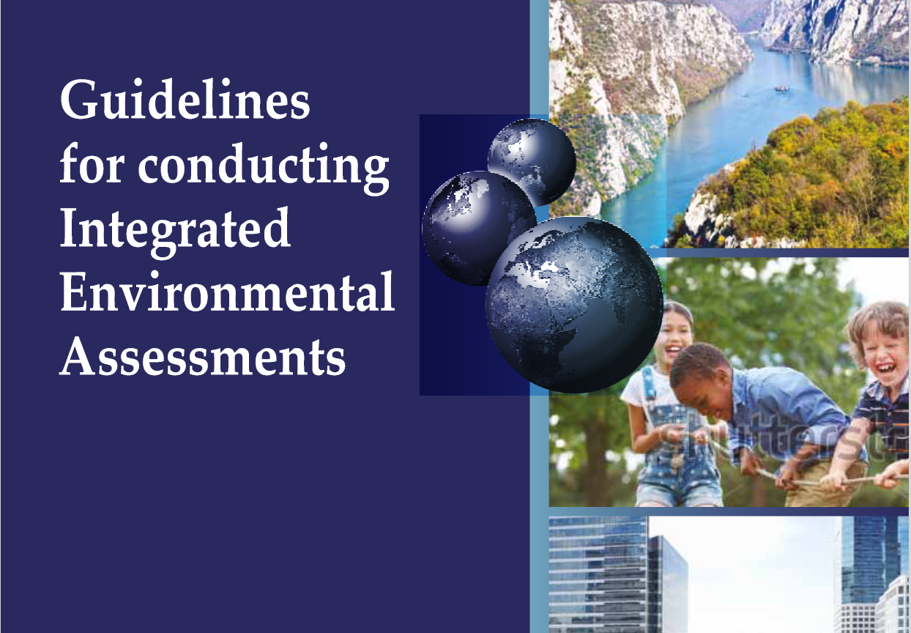
Producing science for decision-making
Environmental challenges
Complex, systemic problems with human and planetary health impacts.
Economic and social impacts, both from the environmental issues themselves but also the mitigation measures.
Problems of collective action, either overuse of resource or pollution created by a large population.
Solutions typically require collective action.
Notes:
Learning Objective: The importance of science for decision making due to complex and interlinked environmental issues caused by and with human impacts
Proposed speaking points
In the environmental context, UNEP uses and develops a lot of science for decision-makers because a lot of the Multi-lateral agreements, including the Paris agreements, biodiversity Aichi targets, etc. require understanding of the environmental interaction with the world
Complex systemic problems with planetary and human health impacts which then result in economic and social impacts
Therefore, there’s a need to understand how work in the environment will impact the economy and society as well as how human activities including the global economies and societies impact the environment
Systemic issues stem from overuse of environmental resources and overall human impact on the environment
These are problems of collective action, such as overuse of resources or pollution created by large populations like transportation so to resolve these issues governments must work together

Slide 5
Clear policy goals
Defining the policy question
Science helps define the problem. Provides the ‘what?’ and the ‘by when?’ of the policy question.
Policy analysis, social science, economic analysis provides the ‘how’.
Engaging the different affected groups helps enable the ‘how’.
Creating partnerships for implementation will likely broaden the engagement of different actors.
Designing policies with multiple benefits for different actors usually deepens the commitment.
Reduce demand growth
De-carbonize
Notes:
Learning Objective: What can science for decision making produce?
Proposed speaking points
Science cannot always provide all answers, but can usually identify the key problems and the timeline to resolve the problem
Graph developed from the findings of the Global Environment Outlook and IPCC
The example on the screen shows the amount of fossil fuels that would need to be removed and by when to achieve a 1.5-degree world.
We need to reduce demand and decarbonize at the same time to reach environmental goals
Analysis in environmental assessments shows what needs to be done by when
Then policy analysis provides ‘how’ these issues can be solved and the resulting economic and social impacts
Interactions with multiple stakeholders and actors usually provides possibility to implement policies

Slide 6
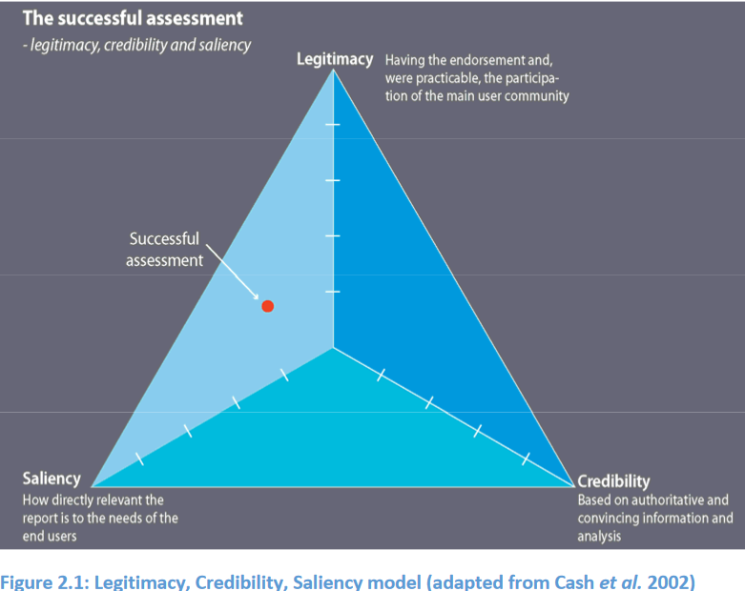
Relevance, legitimacy and credibility
Policymakers and scientists
Typically speak ‘different language’.
Have different needs when producing science for decision making.
Policymakers need science that can be directly applied to their policy problem (relevant, salient)
To encourage collective action, science must be viewed as legitimate (independent, views are geographically and gender balanced).
Scientists must be seen to produce evidence through a credible process (peer reviews, published, etc.)
Notes:
Learning Objective: Process for science and policy
Proposed speaking points
When creating science for policy-making, there are three main criteria, the legitimacy, credibility and saliency
Science needs to be in an easy to understand language for policy-makers
The science must understand the needs of the policy makers, the science needs to be produced with the users/audience in mind to have this lens for the final product to be as useful as possible
The science must be viewed as legitimate and credible including a rigorous scientific process in terms of peer review
Policy needs to encourage collective action

Slide 7
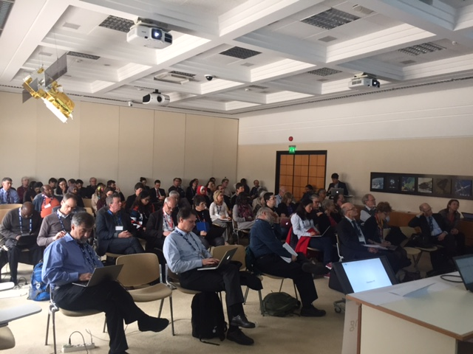
Adjustments needed as process moves on
Differences of opinion, changes in approach
Empirical scientists, social scientists work in different ways.
Differing interpretations across different groups of scientists.
Reconciling science from different published literature.
‘Assessing’ existing literature rather than conducting new research.
Creating a compelling narrative rather than a scientific paper.
Using other visuals effectively (graphics, maps, multimedia)
Notes:
Learning Objective: How does the scientific process work?
Proposed speaking points
In the assessment process, scientists have different ways of working, and bringing together these methods and views is a key role of UNEP
There’s a need to reconcile different scientific views in the assessment
Conducting assessments involves reviewing and understanding existing literature and presenting it in a compelling narrative for policymakers

Slide 8
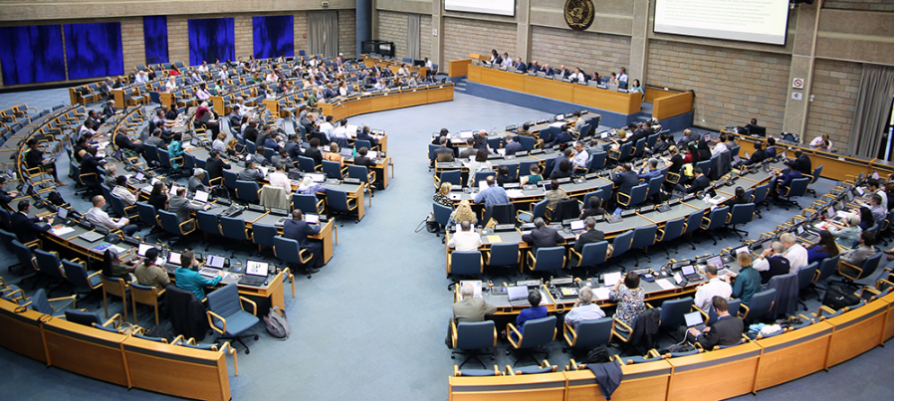
Thank you
Contact: ignacio.sanchez@un.org
Notes:
That’s the process of creating science for decision making and happy to take any questions.
Some UNEP resources:
Guidelines for conducting scientific assessments https://www.unep.org/explore-topics/environment-under-review/what-we-do/environmental-assessment/guidelines-conducting
The Global Environment Outlook: https://www.unep.org/global-environment-outlook
The Making Peace with Nature Report https://www.unep.org/resources/making-peace-nature

