Slide 1

Presentation: Introduction of approaches to STI policy for SDGs and gender in STI
Training Workshop on
Science, Technology and Innovation (STI) Policy and Policy Instruments
for Sustainable Development Goals (SDGs)
Session 1: Approaches to STI Policy- making in the context of SDGs, with focus on open science and gender equality
Ms Kornelia Tzinova

Slide 2

























The Sustainable Development Goals
17 global goals to eradicate poverty, protect the planet and ensure prosperity for all by 2030
PEOPLE
PLANET
PARTNERSHIP
PEACE
PROSPERITY
Accepted by all countries and apply to all
Everyone has to do their part: governments, the private sector, civil society
Not legally binding, but governments expected to establish national frameworks for their achievement, monitor and review progress

Slide 3
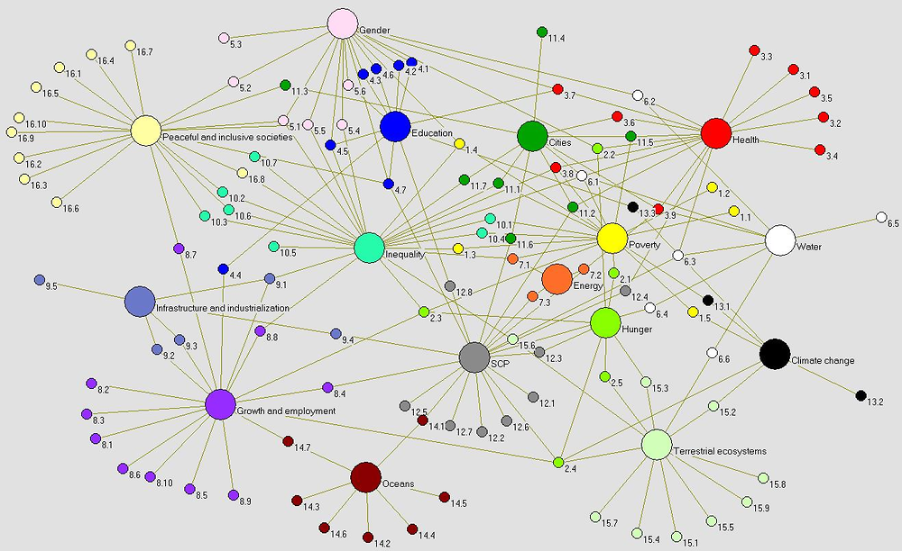

Interrelationships between Sustainable Development Goals
Fuente: David LeBlanc (2015). Towards integration at last? The sustainable development goals as a network of targets. DESA Working Paper No. 141.

Slide 4

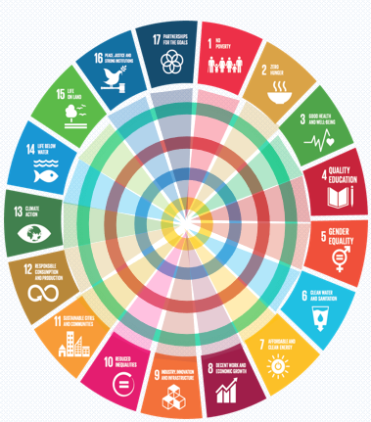







STI is systemic
Time dimension : Where does a country want to be in 5, 10 ..years?
STI play a key role in achieving targets across all SDGs
Building a Robust STI System requires:
National (Regional) STI Systems
Variety of institutions and actors
Linkages and interactions
Exchanges and flows
Varieties of Policies
STI
Other policies
Legal Framework

Slide 5
STI Policy Cycle: participatory processes
Setting the Agenda of STI
STI Policy Formulation
STI Decision Making
Implementation of STI Policies
Policy Evaluation
Involves actors and institutions
in determining problems that require
government action
both State and societal actors take part
identifying and assessing possible solutions to policy problems; social actors play key role
governments put STI policies into effect : confrontation with reality
Governments adopt a particular STI course of action or non-action

Slide 6



What a STI Policy might want to address？
Broad goals: Developing research, innovation, science education…
National development plans
Key sectorial priorities
Legal framework
Governance framework
Organizational structure (Institutions, Private, Public, Universities, non-Profit)
Policy instruments
Gender and youth
STI Policy
Capacity building
Funding mechanisms
Monitoring and Evaluation
Regional and international co-operation

Slide 7


Other strategic STI policy issues
in the context of SDGs :
STI from a national to an international perspective, cooperation
Fostering multi-stakeholder partnerships for investments in STI for SDGs
Transition to Open Science: Open Access to Data and Knowledge, Open Infrastructures, Citizen Science.. more transparent and accountable to society
Science Diplomacy
Giving directionality in STI policies towards STI related targets of the SDGs
Inclusive STI policies, gender, indigenous knowledge
Monitor and measure contribution of STI to SDGs implementation with improved STI indicators
STI Policy

Slide 8

The UN-Inter-agency Task Team (IATT ) Guidebook
Framework for developing STI for SDGs roadmaps, a series of six sequential steps

Slide 9





Gender equality in STI for the achievement of SDGs
4.3 by 2030 ensure equal access for all women and men to affordable quality technical, vocational and tertiary education, including university
9.5 Enhance scientific research, upgrade the technological capabilities of industrial sectors in all countries….., encouraging innovation and substantially increasing the number of research and development workers per 1 million people and public and private research and development spending
5.5 ensure women’s full and effective participation and equal opportunities for leadership at all levels of decision-making in political, economic, and public life
17.18 …enhance capacity building support to developing countries, including for LDCs and SIDS, to increase significantly the availability of high-quality, timely and reliable data disaggregated by income, gender….
8.5 By 2030 achieve full and productive employment and decent work for all women and men, including for young people and persons with disabilities, and equal pay for work of equal value

Slide 10


Women in STI
Although there is growing recognition that STI can contribute significantly to promoting development, STI policies generally lack a gender perspective
Notes:
and therefore do not adequately and equitably address all development concerns

Slide 11




Towards inclusive STI policy with gender dimension
Ghana
National Science, Technology and Innovation Policy 2017-2021
The chapter 4 establishes that `the Government of Ghana has placed STI at the center of the country´s development agenda. [… ] Every effort will be made to achieve gender balance`.
Notes:
As the benefits of diversity and inclusiveness in STI become increasingly obvious for research excellence and relevance, many countries have established strategies and introduced policy initiatives to promote gender equality in STI

Slide 12

Towards inclusive STI policy with gender dimension
Revised National Science, Technology, and Innovation Policy (NSTIP) 2020–2030
One of the policy guiding principles considers that a gender and equity sensitive approach has the potential to define appropriate interventions[…].
All STI interventions shall aim to systematically address their concerns through gender and equity analysis and planning.
.
Namibia
  Objective 4: To improve gender equality and mainstreaming in STEM.
  Strategy 1: Establish and improve programmes that support women’s participation in STEM, science careers and as leaders and decision makers.
  Strategy 2: Support the role of women in innovation systems. Design, develop and implement gender-responsive innovation support programmes

Slide 13



Under-representation of women in STI
Lack of data on women in STI can obstruct the design, monitoring and evaluation of the STI policies that aim at gender equality
Some international sources for data on women in STI:
UNESCO Science Report
UNESCO GO-SPIN Platform-women in STEM portal
OECD’s STIP Compass’s gender balance and inclusiveness dashboard.
WEF Global Gender Gap Report
22%
of professionals in artificial intelligence are women
2%
of venture capitals goes to
start-ups founded by women
Notes:
The under-representation of women in many fields of STI has long been a source of concern.
Data..
Lack of data on women in STI can obstruct the design, monitoring and evaluation of the STI policies that aim at gender equality
Some sources for data on women in STI

Slide 14






Questions for thoughts
How to align STI governance structures to the global SDGs framework? (policy advice, steering and funding, co-ordination, and evaluation and monitoring…)
How to reframe STI policy from a unique economic rationale to SDGs perspective?
How to meet goals of environmental sustainability and at the same time economic growth?
How to define directionality and concrete mission goals responding to environmental and societal needs within STI policies?
What priority areas for action to embed SDGs within STI policy frameworks?
What frameworks for STI are needed for inclusion in decision-making?

Slide 15



