Slide 1
MUTUAL LEARNING EXERCISE ON R&I STRATEGIES AND POLICIES
Session 1: STI Policymaking and SDGs
Case study on directionality
Dimo CALOVSKI (Mr.)
Science, Technology and Innovation Policy Section
UNCTAD Division on Technology and Logistics
dimo.calovski@un.org
Addis Ababa, Ethiopia
14-17 February 2023

Slide 2
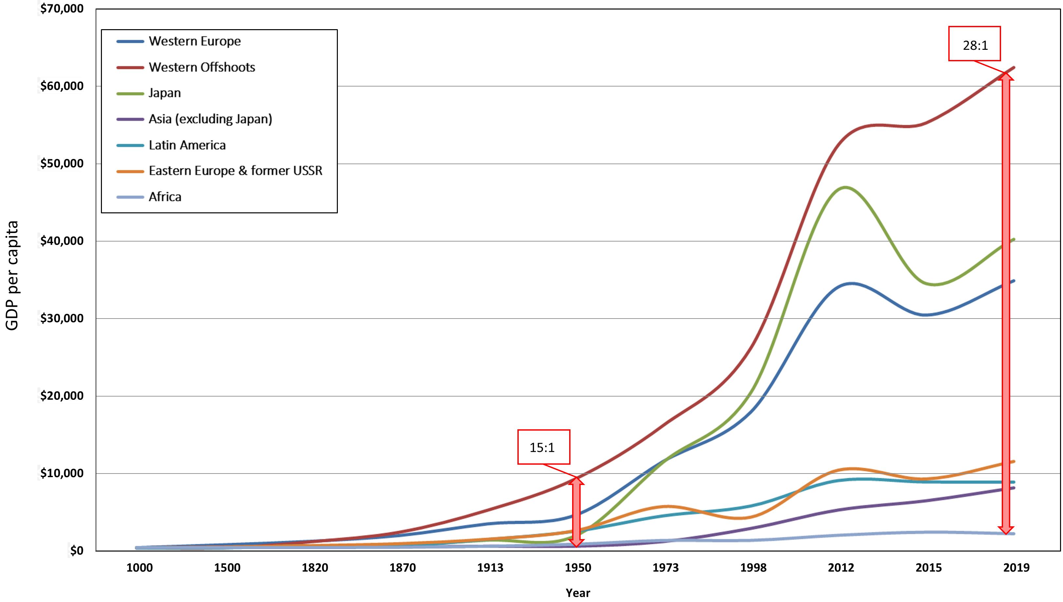

Slide 4
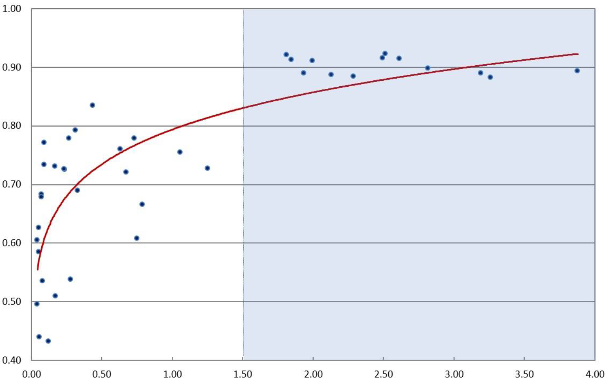
Human development index, 2014
R&D as % of GDP, average 1996-2014 = STI policy strength?

Slide 5
Human development index, 2014
R&D as % of GDP, average 1996-2014 ( = STI policy strength? )

Slide 6
What is innovation?
Apple iPhone 4 smartphone

Slide 7
What is innovation?

Slide 8
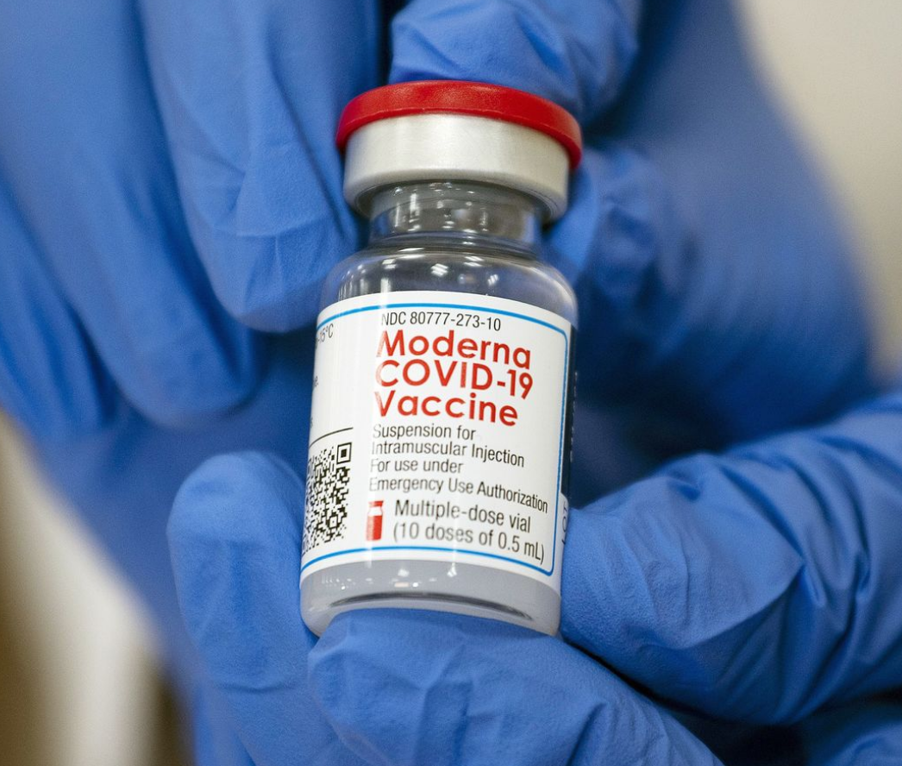
What is innovation?
vaccine Moderna mRNA Covid-19 vaccine

Slide 9
What is innovation?

Slide 10
Q: STI policy – why do we need it?

Slide 11
Q: STI policy – why do we need it?
A: To combat failures…
Market failure (not enough S&T to impact Innovation)
Transition failure (institutions)
Transformational failure (directionality)

Slide 12
STI policy and SDGs – directionality rationale
Coherence between national development strategy and policies and SDGs
SDGs: Blueprint for a better and more sustainable future for all
SDGs: Key challenges are interconnected!
SDGs: Help address transformation, provide directionality

Slide 13
STI policy and SDGs – directionality rationale
Coherence between national development strategy and policies and SDGs
SDGs: Blueprint for a better and more sustainable future for all
SDGs: Key challenges are interconnected!
SDGs: Help address transformation, provide directionality

Slide 14
Current policy | Relevant SDGs | Challenges – Objectives? | Relevant technologies | Ways forward ✓✓✓
Subsidized price of Seed (maize) Fertilizer Intervention to provide maize to millers in districts where crop has failed Banning maize exports when crop yield below average Focus: farmers and millers, i.e., supply side: producers and intermediaries |  | Universal and secure access to healthy food: Enabling innovation in production, distribution, consumption to impact … Economical production of adequate calories Diverse diet and high nutritional quality contributing to public health Gender equality and reduction of income, rural and other inequalities Environmental preservation and conservation (soil erosion and biodiversity) Focus: beneficiaries, group of interdependent actors, includes consumers, nature | Water management Sustainable tilling (e.g., shallow ploughing) Waste recovery (energy source, bio digestors) Digital enhanced precision agri Digital extension Enhanced meteorology (computational, predictive, satellite technology) Fintech (financial empowerment for women and rural populations) | Developing holistic and systemic approach embracing all stakeholders and beneficiaries Reposition food system i/o agri sector in NDP Improving coordination between agri research and innovation support Enabling Climate Smart Agriculture Support for business model innovation Pairing innovation, ICT, with fintech and financial inclusion Linking STI with Agri and Industrial policies

Slide 15
STI and SDGs – directionality rationale
Provide for directionality Example: Agriculture, SDGs and STI in …
RECOMMENDATION 1: consolidate a knowledge base on STI for food system transformation.
RECOMMENDATION 4: develop a vision on pathways for food system transformation.
RECOMMENDATION 2: improve coordination on STI policy for the food system.
RECOMMENDATION 5: formulate an STI-led strategy to foster food system transformation.
RECOMMENDATION 3: build a multi-stakeholder STI food system governance.
RECOMMENDATION 6: build evaluation and learning capacity for better implementation.

Slide 16
THANK YOU!

Slide 17
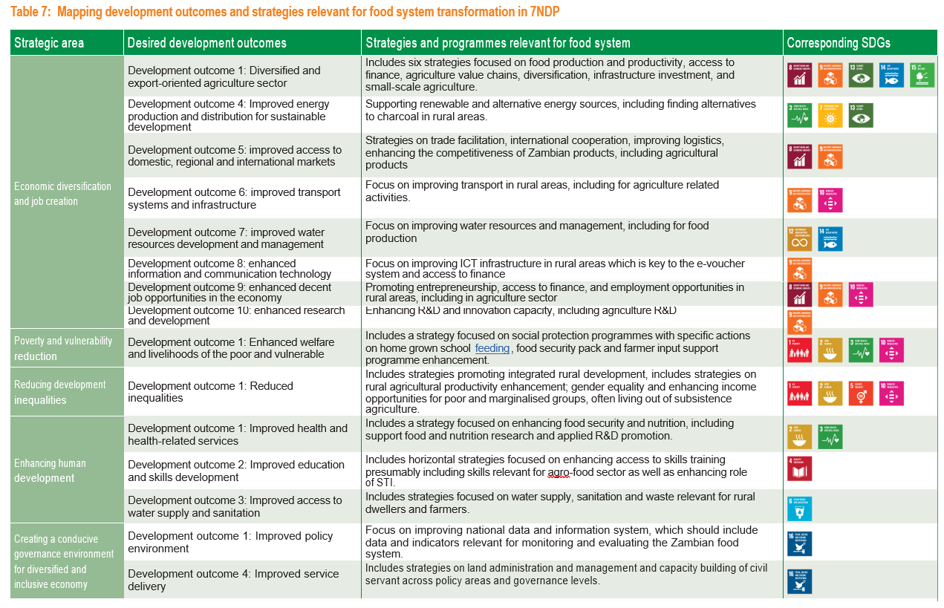
STI policy under review
Provide for directionality Example: Agriculture, SDGs and STI in …

Slide 18
