Slide 1
Mutual Learning Exercise on Research and Innovation Strategies and Policies Solomon ( Ph.D.) and Desta Abera Ministry of Education and Ministry of Innovation of Ethiopia Addis Ababa, Ethiopia 14-17 February 2023

Slide 2
Content
Background
R&I Ecosystem
Transformation and Development Impact
Conclusion

Slide 3
STI.
Policy and strategies
STI Support
STI role
Role of on nation economy
1200+USD
PP; 120+mil
Low income/230 USD
PP: 42 mi
ST policy
Income/540USD
PP62 mill
STI support system
780USD
PP 85+ mil
Ethio
1970s
Ethio
1980s
Ethiopia
2000s
Ethiopia
2020s
Ethiopia
Current
From Agri TO Tech. adoption, adaption, Technology transfer ( capacity building)…..Technology dev`t???

Slide 4
Background …
Institutes
MInT From Facilitator to Main Actor

Slide 5
Background…(STI policy Of Ethiopia (2022))
Ethiopian STI Policy
Technology Transfer
Human Resource Development
Cooperation and relation
Research and Development
Job creation
Wealth creation
GDP contribution
Social , Cultural and Environmental Issues
Finance & Incentives system
Quality and IP System
Innovation and Entrepreneurship Development
From Facilitator to Main Actor

Slide 7
Research and Innovation Ecosystem …
Key Institutions and Supportive Structure
A) Armauer Hansen Research Institute (AHRI)
AHRI is a Biomedical research Institute in Ethiopia which is working in tuberculosis, HIV, malaria, Leishmaniasis, training and research capacity building.
Health Research Institutes
B) Ethiopian Public health institute (EPHI)
MInT From Facilitator to Main Actor
Notes:
MoST From Facilitator to Main Actor

Slide 8
Research and Innovation Ecosystem…
Manufacturing Industries Development Institutes
Institute currently under operation
Textile industry development institute;
Leather industry development institute;
Metal industry development institute;
Food, beverage and pharmaceutical industry development institute;
Chemical & construction input industry development institute;
Meat & Diary industry development institute
Industrial Research Institutes(IGRI’s)
Institute planned to be established in the near future
Industrial development capacity building institute;
Industrial R&D and technology transfer institute;
MInT From Facilitator to Main Actor

Slide 9
Research and Innovation Ecosystem ….
Key Institutions and Supportive Structure For Innovation Development
Business zone
Commercial zone
ICT Village
Knowledge zone
Assembly & warehouse zone
MInT From Facilitator to Main Actor

Slide 10
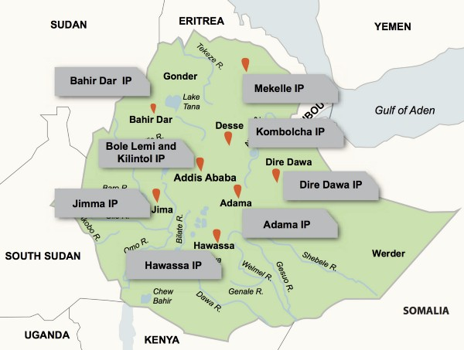
Research and Innovation Ecosystem …( Industrial parks)
Key Institutions and Supportive Structure
Industry Policy
Kilinto Industrial Park
Medical devices
Adama Industrial Park
manufacturing
Dire Dawa Industrial Park
Heavy machinery and electrical equipment
MInT From Facilitator to Main Actor

Slide 11
Transformation and Development Impact
Key Institutions and Supportive Structure
National Science, Technology and Innovation Council (NSTIC) :
chaired by PM
member of council – STI related sectors like agri, health industry, education ,private sectors ,
B. National Science & Technology Research Council (NSTRC) :
General Assembly;
Sector based research councils;
Technical Committees;
MInT From Facilitator to Main Actor

Slide 12
Transformation and Development impact …
Key development impact
The Education and Training, Research Intuitions and Industry Linkage (ETRIIL)
NUILF( 24+
SUILF (121+)
Agriculture
Textile
Leather
Metal Engineering
Food, beverage & pharmaceuticals
Meat & dairy products
Chemical & construction input
Sugar
Mining
Railway
Road
Irrigation
Energy
Construction & housing development
Telecommunication & ICT
Tourism
Health
SUILF-1
SUILF-2
SUILF-3
…
FUIL
MInT From Facilitator to Main Actor

Slide 13
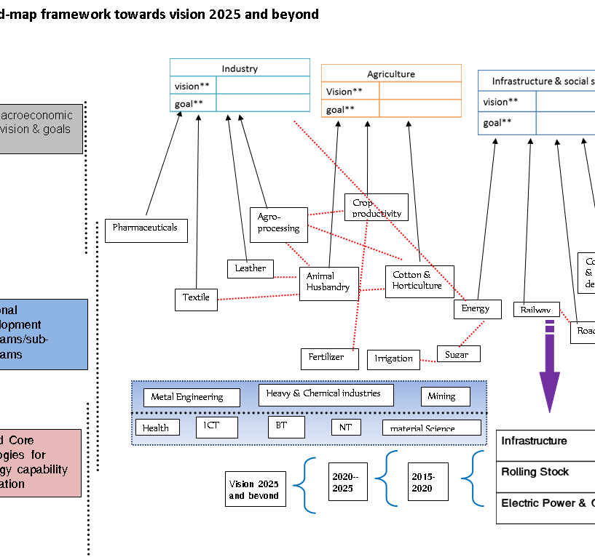
Transformation and Development impact ….
Transformative Initiatives
STI sectoral road-map framework towards vision 2025 and beyond
Major Macroeconomic sectors vision & goals
Construction & housing development
National development programs/sub-programs
Road
Identified Core Technologies for technology capability accumulation
MInT From Facilitator to Main Actor

Slide 14
Transformation and Development impact
Transformative Initiatives
Education Sector- and new road maps
Indicator |  | Baseline | Target ()
TVET | Total no. of TVET (at least one in each “wereda”)
 | Total no. of regular students admitted to TVET
University | Total no. of public universities
 | Total no. of students admitted to under graduate degree program
 | Percentage of girls in under-graduate program
 | Post graduate enrollment
 | Percentage of female in master program
 | Percentage of female in PhD program
STUs and research universities
Universities differentiations
MInT From Facilitator to Main Actor

Slide 15
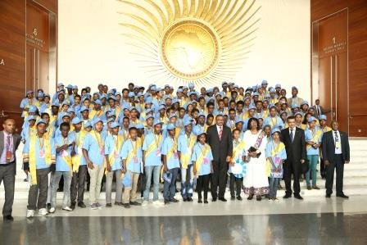
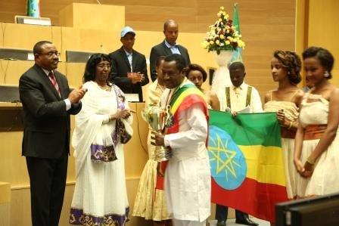
Transformation and Development impact …
Transformative Initiatives
National STI Award (9th )….Since 2002 E.C. 1856+….
Regional Science and Technology Institutions
Talent School( Burayu)
Science Café/ Innovation hubs/ incubation centers
Betre-Science/ educational capacity building
Digital Ethiopia /
MInT From Facilitator to Main Actor

Slide 16
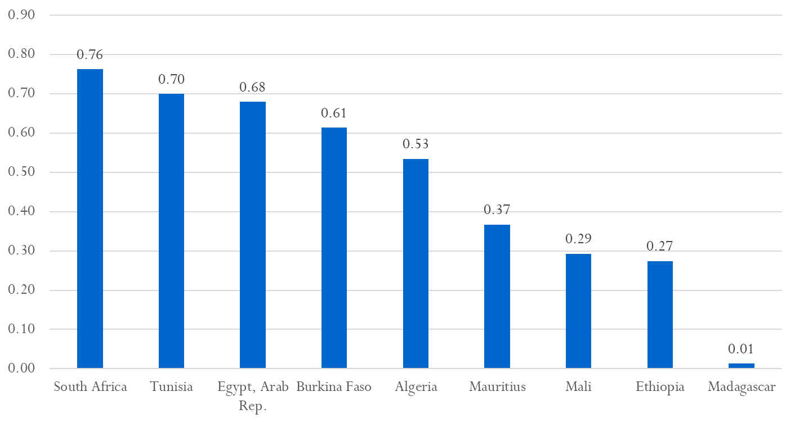
Transformation and Development impact
From 0.27 to 1 % in 5-10 years
R&D/GDP (2014 and other years, World Bank)
MInT From Facilitator to Main Actor

Slide 17
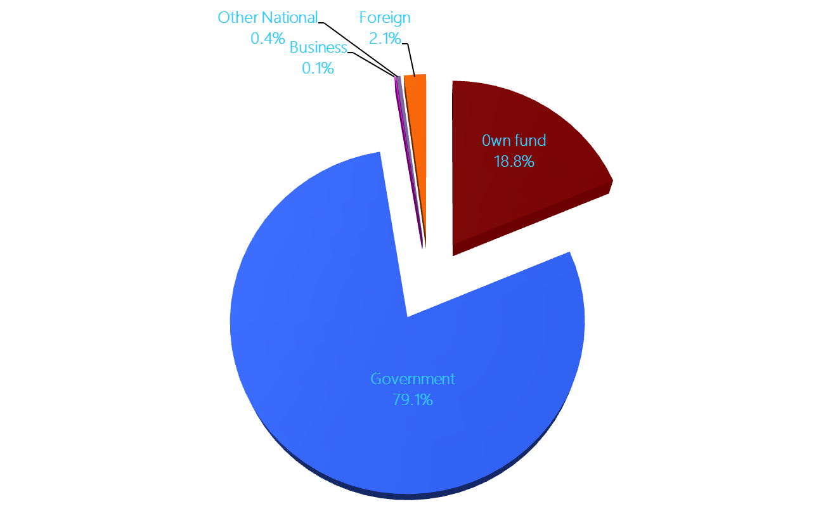
Transformation and Development impact …
Private research institution establishment
Sources of GERD Funds(STIC, 2014)
R&D is largely divorced from productive activities
MInT From Facilitator to Main Actor

Slide 18
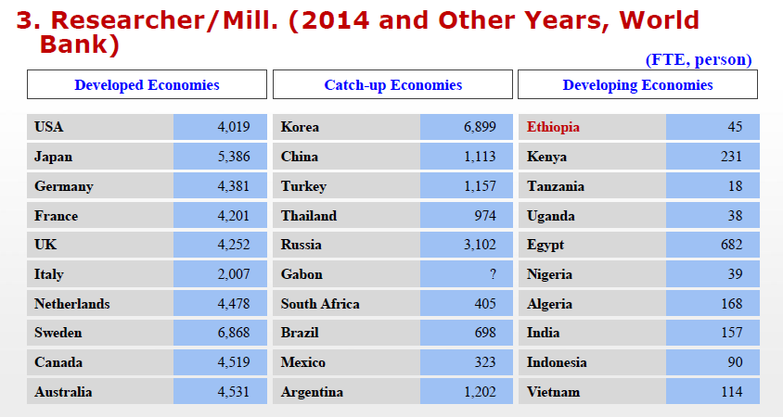
Transformation and Development impact …
Human resource development ( skilled and futuristic
Researcher/Mill (2014 and other years, World Bank)
Developing Economies (STIC/2014)
Ethiopia | 95
Burkina Faso | 72
Ghana | 104
Kenya | 321
Senegal | 657
Uganda | 84
MInT From Facilitator to Main Actor

Slide 19
Transformation and Development impact …
Researchers background (STIC 2014)
MInT From Facilitator to Main Actor

Slide 20
Transformation and Development impact …
Home based technology dev`t and Enabler technology transfer
Intellectual Property (EIPO, 2017)
 | Application |  |  | Granted
 | Foreign | Local | Total | Foreign | Local | Total
Patent | 385 | 5 | 390 | 84 | 5 | 89
Utility Model |  |  | 2591 |  |  | 831
Patent of Introduction |  |  | 253 |  |  | 163
Industrial Design |  |  | 2776 |  |  | 775
MInT From Facilitator to Main Actor

Slide 21
Conclusion …
Major challenges
Resources allocation especially for Research and Innovation development should be prioritized and recognized by government and development partners.
coordination challenges among STI actors should be underscored by government and STI sectors
National and Regional Innovation system should be strengthen through stake holders participation.

Slide 22
Thank You!!! አመሰግናለሁ!!!

